Slide 1
Personal savings in the United States are less than 2% of disposable income. Yet, savings are important for economic growth as businesses and the governments borrow these funds for investment.

Slide 2
Today’s Essential Question:
The choices you make with your money determine the quality of your life.
You know that savings affects your future, but how does savings impact the economy as a whole?

Slide 3
Choosing a type of savings account depends on what you’re saving for!

Slide 4
Ask yourself these questions…
1. What are you saving for?
2. How comfortable are you with risk?
3. How liquid do you need your savings to be?

Slide 5
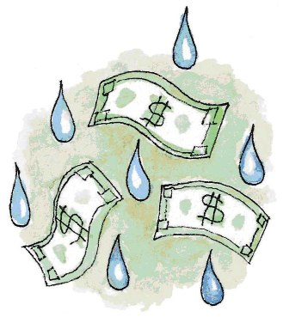
LIQUIDITY
Refers to how easily or quickly you can withdraw your money.
EX: Accounts with high interest rates require that you do not withdraw funds for a given amount of time AND may charge fees if you do so.
The money in this type of account is “less liquid”

Slide 6
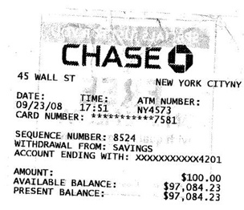
BALANCE
The amount of money in your account.

Slide 7
MATURITY
The length of time that money must be deposited

Slide 8
SAVINGS ACCOUNT
The most basic way to start saving.
Make deposits and withdrawals by visiting the bank or using an ATM Card.
Withdraw at any time, but interest rates are low.
PROS: low risk, high level of liquidity
CONS: low interest rate

Slide 9
CHECKING ACCOUNT
A deposit account for the purpose of providing convenient access to your funds whenever and wherever you want them.
Many require a minimum balance in order to maintain an interest rate and to avoid banking fees.
PROS: low risk, high level of liquidity
CONS: low interest rate, usually requires a balance to avoid fees.

Slide 10
MONEY MARKET ACCOUNT
Combines the best features of both a savings and a checking account.
You can earn interest on the principal in your account and the interest rate is higher than a regular savings account.
You can write checks, but you are limited in the amount of checks that you can write.
Can charge you a fee for going below a certain balance

Slide 11
MONEY MARKET ACCOUNT
PROS: better interest rates, high liquidity
CONS: requires a greater initial deposit, may have limited transfers/withdrawals

Slide 12
CD (Certificate of Deposit)
Best suited to those who have funds that can remain completely untouched for longer periods of time.
They have a specific fixed term (Maturity) and usually a fixed interest rate.
PROS: Higher interest rates, often insured by Gov.
CONS: Fees charged to you if you withdraw money before maturity, Low liquidity.

Slide 13
SAVINGS BONDS
Issued by the federal government
Little risk because bonds are guaranteed by Gov. funds
Purchase for less than face value and redeem @ face value upon maturity.
By selling bonds, the government gains money for Gov. funded programs.

Slide 14
You know that savings affects your future, but how does savings impact the economy as a whole?

