Slide 1
THE ECONOMIC WAY OF THINKING
Unit 1, Lesson 1

Slide 2
EVERYTHING HAS A COST
The basic idea that “there is no such thing as a free lunch.”
EVERY action costs someone TIME, EFFORT, or LOST OPPORTUNITES to do something else.
Also knows as: OPPORTUNITY COST

Slide 3
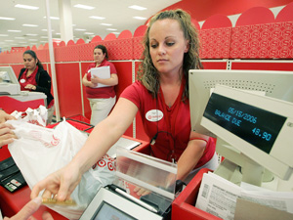
Make up your own “opportunity cost” scenario.

Slide 4
PEOPLE CHOOSE FOR GOOD REASONS
People always face choices and they should choose the alternative that gives them the most advantageous combination of costs and benefit.
People have different values so they tend to make different choices

Slide 5
INCENTIVES MATTER
Economics is about incentives
When incentives change, people’s behavior change in predictable ways

Slide 6
PEOPLE CREATE ECONOMIC SYSTEMS TO INCLUENCE CHOICES AND INCENTIVES
Cooperation among people is governed by written and unwritten rules that are the core of an economic system.
As rules change, incentives and behavior change.

Slide 7
PEOPLE GAIN FROM VOLUNTARY TRADE
People trade when they believe the trade makes them better off.

Slide 8
The value of goods and services is affected by people’s choices
The value of goods and services is determined by the preferences of buyers and sellers.
The price of a good or service is set by supply and demand.

Slide 9
MAIN IDEA: Societies do not have enough productive resources to satisfy everyone’s wants and needs
UNLIMITED WANTS & LIMITED RESOURCES!

Slide 10
SCARCITY
The condition that results from society not having enough resources to produce all of the things that people would like to have.

Slide 11
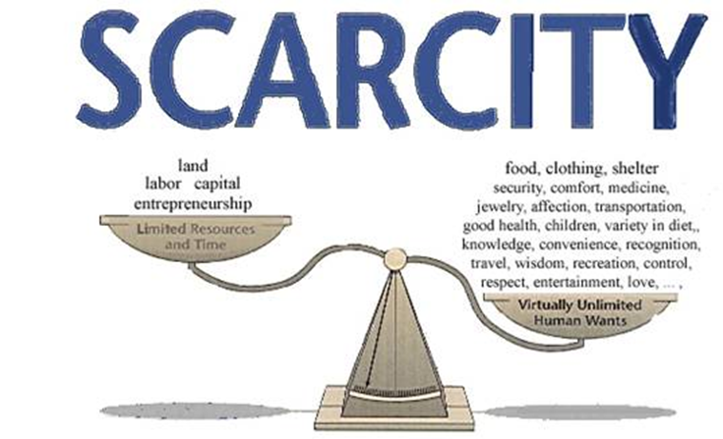

Slide 12
ECONOMICS is:
The study of how people try to satisfy seemingly unlimited and competing wants through the careful use of relatively scarce resources.

Slide 13
What is the difference between a need and a want?
How do limitations on people’s time and income affect these needs and wants?

Slide 14
3 BASIC ECONOMIC QUESTIONS
HOW do we decide how to properly use the limited resources in our economy?

Slide 15
WHAT to produce
Should a society direct most of its resources to the production of military equipment or to other items such as food, clothing, or housing?

Slide 16
HOUSING
A SOCIETY CAN NOT HAVE EVERYTHING ITS PEOPLE WANT, so it must decide WHAT to produce.
Low income?
Middle income?
Upper income?

Slide 17
SO…
What about healthcare?

Slide 18
HOW to produce
Should factory owners use automated production methods that require more machines and fewer workers?
OR… should they use fewer machines and more workers?
If a community has unemployed people, using workers might be better.

Slide 19
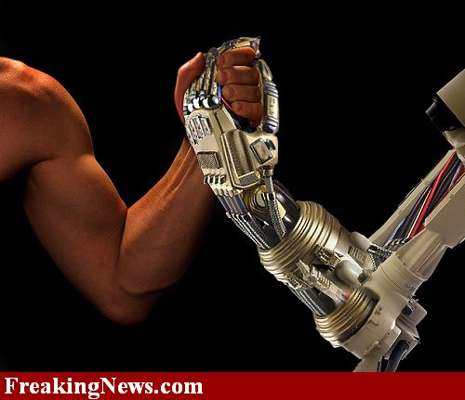
VS.

Slide 20
HOWEVER…
In countries where machinery is widely available, automation can often lower production costs. Lower costs make manufactured items less expensive and, therefore, available to more people.

Slide 21
FOR WHOM to produce
If a society decides to produce housing, for example, should it be the kind of hosing that is wanted by low-income, middle income, or professional workers?

Slide 22
REFLECT:
IMAGINE YOUR OWN COMMUNITY:
What if a residential developer bought out the Kline family farm and built a subdivision of…
$600,000-$800,000 brick mansions
OR
Low income apartment buildings?
How would that affect the community, businesses, and even your own family?

