Slide 1
Providing Public Goods
Chapter 12, Section 2

Slide 2
Providing Public Goods
Federal, State, and Local governments frequently share the responsibility of funding and distributing public goods.
It can charge (or tax) all citizens
for the cost of public goods
even if some people do not use
the goods directly.

Slide 3
Public Goods
The government must make public goods available to all citizens, thought citizens can decide for themselves whether to use those goods.

Slide 4
Shared Responsibility
Some goods and services are found at each level of government.
courts, corrections, law enforcement
Others are the primary responsibility of one level of government with funding from other levels of government.
Local gov. manages public education but receives state and federal funding

Slide 5
Shared Responsibility
ONE EXCEPTION
National Defense
Provided solely by the federal government

Slide 6
Privatization
Privatization refers to either the sale of government property or to the handling of government services by private businesses.
Garbage collection
Hospitals

Slide 7
Why Privatize??
Private businesses might be able to operate certain industries more efficiently
Some argue that the government should not compete with private business
Government could reduce its costs and pay off some debt…

Slide 8
Why Privatize??

Slide 9
Promoting Economic Well Being
To fulfill this function, the government works to improve people’s standard of living and to redistribute income among citizens.

Slide 10
Improving the Standard of Living
The standard of living for a nation, state, or region reflects how people live and how many goods and services they consume.
Where do you and your neighbors buy food?
How many people are likely to own consumer goods such as television sets, computers, and stereo systems?
What educational opportunities are available and how many people take advantage of them?

Slide 11
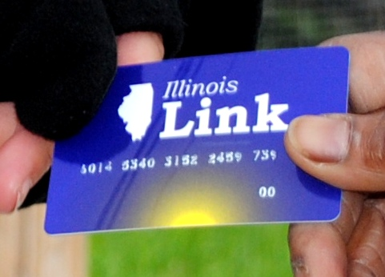
Improving the Standard of Living
Diet
Product Consumption
Medical Care
Education
Four areas that affect people’s standard of living and for which the government has shown a high degree of concern.

Slide 12
Improving the Standard of Living
Medicare and Medicaid provide health insurance to older Americans and to people with low incomes.
The government also helps hospitals cover the cost of treating people who do not have insurance.

Slide 13
Redistributing Income
Some government programs are designed to reduce the gap between rich and poor.
The government tries to accomplish this through a system of transfer payments.
Transfer Payment: the government takes money collected from one group of citizens and distributes it to another group of citizens.

Slide 14
Redistributing Income
Social Security payments to older people and people with disabilities
Food stamps
Reduced transportation prices
Food Deliveries

Slide 15
Moderating the Business Cycle
Prior to the Great depression, the government did not attempt to stabilize the business cycle.
During the 30’s and after WWII, the federal government greatly expanded its role in managing the economy.
Today, the government tries to steer the economy on a middle course that avoids recession and inflation.

