Slide 1
GROWTH OF GOVERNMENT
Chapter 12, Section 1

Slide 2
What organization employs the greatest number of people in the United States?

Slide 3
Population Growth
Historically: 13 states to 50 states
More government employees are needed to meet the needs of a larger population.
WHY?
Notes:
More educational facilities, increased road construction and repair, more police protection, larger nation defense forces

Slide 4
Changing Public Attitudes
Laissez-Faire economics: based on the belief that the economy does best without government interference
Before the 30’s, most people supported laissez-faire economic policy.
Why did people’s attitudes change after the 30’s?

Slide 5
Changing Public Attitudes
People began to recognize the need for government intervention in the economy.
FDR and “The New Deal” Programs designed to put people back to work
Population increases = more assistance for traditionally disadvantaged groups (minorities and poor)
Medicaid, foster care, veteran’s pensions, etc.

Slide 6
Rising Standard of Living
Once people earn enough $$ to meet their basic needs, they then look for other ways to fill their wants.
People begin to spend more and increase their standard of living.
Export goods and services & Increased consumer protection

Slide 7
National Emergencies
War = government increases in size
WWI: civilian employees of fed. Gov. doubled
WWII: 402,000 -> 855,000
Dropped after both wars, but never fell to pre-war levels

Slide 8
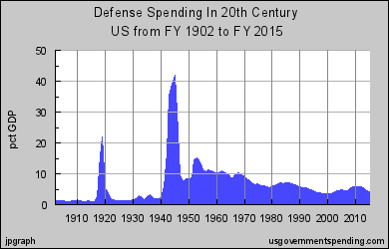
Defense Spending since 1900

Slide 9
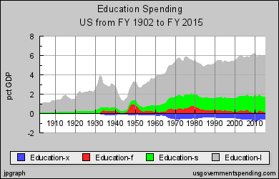
Education Spending since 1900

Slide 10
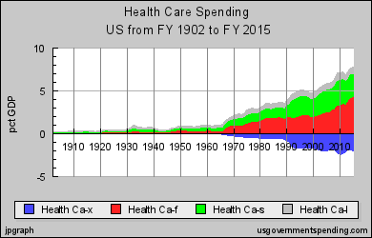
Health Care Spending since 1900

