Slide 1
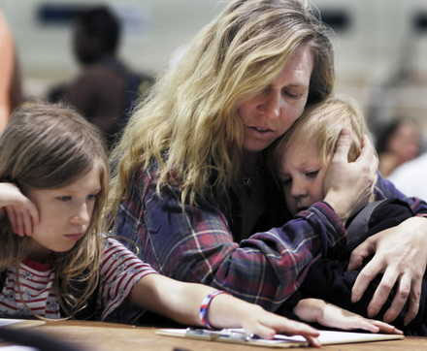
Poverty & Income Distribution
Chapter 11, Section 3

Slide 2
Poverty in the United States
Another way to examine the economic well being of a nation is to measure the number of people who are living in poverty.

Slide 3
Poverty Threshold
Poverty level
Lowest income, as determined by the government, that a family or household of a certain size needs to maintain a basic standard of living

Slide 4
Poverty Rate
The percentage of individuals or families in the total population that are living in poverty

Slide 5
Distribution of Income
Different economic and social backgrounds
Different Skills
Different Talents
Different neighborhoods
Different schools
Different economic struggles
Different social issues

Slide 6
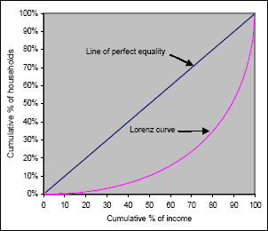
Lorenz Curve
An illustration of the amount that a nation’s distribution of income varies from a perfectly proportional distribution of income.

Slide 7
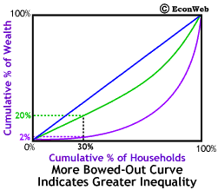
Lorenz Curve
The ore an actual Lorenz Curve dips below this 45-degree line of absolute equality, the greater the amount of income inequality

Slide 8
Gini Index
Another statistical measure of inequality
Ranges from 0.0 to 1.0
0.0 = each family or household receives an equal share of the total income
1.0 = one family or household receives all of the income.
Area above the LC divided by area below the LC

Slide 9
BUT…
The income is based on gross incomes before deductions.
Personal income tax
Social security
Medicare
Health insurance
Union dues

Slide 10
Also..
The income does not include the following:
Food stamps
Health benefits
Low cost housing

Slide 11
Growing Income Gap
Are the rich getting richer and the poor getting poorer?
Growing income gap due to
Changes in Households
Changes in the labor market
Rapid changes in technology
The growth of a global economy

Slide 12
Changes in Households
Married couples with their children make up a large percentage of the wealthier households
Well paid men often marry well paid women boosting income at the top of the income distribution

Slide 13
Changes in Households
Divorce Rates
More out-of-wedlock births
Increasing number of people who live alone

Slide 14
Changes in the Labor Market
Corporate Downsizing
Decline in the real value of minimum wage
Inflation
Increased use of temporary workers
Union membership has decreased

Slide 15
Changes in Technology
Drop in demand for lower skilled workers
Increase jobs for the highly skilled, trained, and educated
Income reflects education
The need for education is more important than ever!

Slide 16
Growth of a Global Economy
Relocation of companies to other countries where laborers will work for less pay
US low skilled workers end up at the bottom of the income distribution

