Slide 1
Pay yourself first!
Don’t treat your savings account as your lowest priority or you will never get around to it!!!!

Slide 2
COMMONCRAFT VIDEO: Saving

Slide 3
Some key terms….
PRINCIPAL
Refers to the amount of money you deposit in your account to begin saving

Slide 4
Some key terms….
WITHDRAWAL
Anytime you take money out of your account
(reduces your principal)

Slide 5
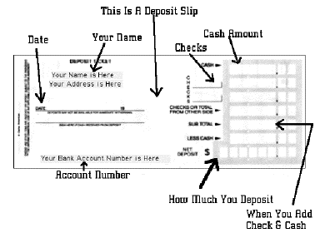
Some key terms….
DEPOSIT
When you add money to your account
(increase your principal)

Slide 6
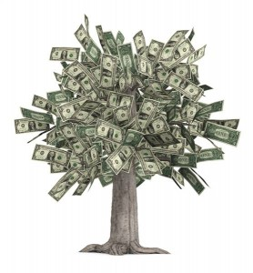
The difference between saving money in a jar at home and in a savings account at a bank is how your principal grows.
At home, your money grows only when you add (deposit) more money in your jar.
In a savings account, your money grows not only when you deposit more money but when you accumulate INTEREST.

Slide 7
Some key terms….
INTEREST
The money the bank pays you for leaving it in your savings account
Kind of like loaning the bank your money
1. You give them money to “hold”
2. They pay you interest so your money grows
3. They are able to use your money to fund loans and investments to other people.
4. Everyone is happy ☺

Slide 8
Some key terms….
INTEREST RATE
The percentage amount of your principal that the bank agrees to pay into your account.
APR= Annual Percentage Rate
1. FIXED- Unchanging, guarantees the same percentage of interest
2. VARIABLE- Can go up and down and is usually determined by economic conditions.

Slide 9
Some key terms….
SIMPLE INTEREST
“Simple” fee paid to you on your principal
Expressed as percentage of the principal over time.
HOW SIMPLE INTEREST IS CALCULATED:
Principal x Interest Rate x Time = Interest Earned

Slide 10
SIMPLE INTEREST
EXAMPLE:
You open a savings account with $1,000 at 5% Simple APR. What will you earn in interest in the first year??
Principal x Interest Rate x Time = Interest Earned
$1,000 x .05 x 1 = $50 in Interest every year.

Slide 11
Some key terms….
COMPOUND INTEREST
Compound interest is what really makes your money grow!!
Each time your interest compounds, it gets added back to your account and becomes part of your principal.
With more principal, the account earns even more interest, which continually compounds into new principal.
It’s a powerful cycle that really adds up!

Slide 12
COMPOUND INTEREST
Depending on the type of account, it may compound daily, monthly, or annually.
After one year, the interest you’ve earned ($50) gets added to the principal for year two.
$1,000 x .05 x 1 = $50
$1,050 x .05 x 1 = $52.50 Interest in Year 2
$1,102.50 x .05 x 1 = ______________ in Year 3

Slide 13
Rule of 72
Want to know how your money will double?
The Rule of 72 is a fast way to estimate how long it will take you to double your savings with compound interest.
72 divided by interest rate = # of years needed to double your money!

Slide 14
Compound interest formula
A = Ending Amount
P = Principal
r = interest rate (expressed as decimal)
n = # compoundings/year
t = total # of years

