Slide 1
GOOD LUCK WRESTLERS & BASKETBALL PLAYERS!!
GO PANTHERS!!!!

Slide 2
INFLATION
Chapter 11, Section 2

Slide 3
You may have heard relatives talk about the good old days when a dollar would buy something. What happened to that dollar? Why won’t it buy as much as it did last month or last year?
What happened is inflation.

Slide 4
When quantity demanded exceeds quantity supplied, prices go up and the purchasing power of a dollar goes down.

Slide 5
Simply put, inflation is a rise in prices relative to money available. In other words, you can get less for your money than you used to be able to get.

Slide 6
You buy a candy bar for 50 cents. A year later, you go to buy the same candy bar and it's 55 cents. You still have only 50 cents, but the price of the candy bar has gone up. We can say that inflation is at work. The price of that bar has been inflated.

Slide 7
People usually refer to inflation when they talk about the prices of large-ticket items, like cars and houses and stocks. But inflation also affects things like groceries and house supplies. It can also affect things like house payments and rent.

Slide 8
When inflation rises but people's paychecks don't, this means that people have spend more of the money to buy the same things that they used to be able to buy for less.

Slide 9
EXAMINING PRICE FLUCTUATIONS
Price Level reflects prices throughout the economy at a particular time
INFLATION and DELFATION refer to changes in the price level over time

Slide 10
AGGREGATE SUPPLY
The total amount of goods and services produced throughout the economy.
The law of supply says that quantity supplied increases as prices rise.

Slide 11
AGGREGATE DEMAND
The total amount of spending by individuals and businesses throughout the economy.
The law of demand applies to aggregate demand, which means that there is a greater aggregate quantity of products demanded when the price level is lower.

Slide 12
INFLATION
An increase in the average price level of all products in an economy is called inflation.
Usually, inflation occurs when aggregate demand increases faster than aggregate supply.
When quantity demanded exceeds quantity supplied, consumers must compete for limited products and prices go up.
As prices increase, the amount that a dollar buys decreases.

Slide 13
DEFLATION
A decrease in the average price level of all goods and services in an economy is known as deflation.
Deflation occurs when aggregate demand decreases more rapidly than aggregate supply.
Sellers are then forced to lower prices to attract buyers.
As prices decrease, the amount a dollar buys increases.

Slide 14
The Causes of Inflation

Slide 15
Economists classify inflation into two general categories based on cause. Demand Pull & Cost Push Inflation. Prices can either be pulled up by high demand, or pushed up by high production costs.

Slide 16
Demand-Pull Inflation
When aggregate demand increases faster than the economy’s productive capacity, demand-pull inflation results.
As demand continues to increase, the prices of goods are pulled even higher.
Demand pull inflation can result from an increase in the money supply or an increase in the use of credit.

Slide 17
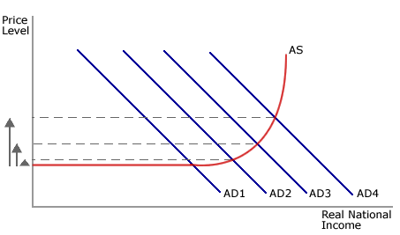
Demand-Pull Inflation

Slide 18
Cost- Push Inflation
When producers raise prices to cover higher resource costs, cost-push inflation results.
Producers must set prices high enough to cover their costs and to earn a profit.
Increased production costs push producers to raise prices even if demand has not increased.

Slide 19
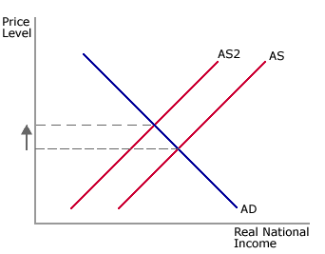
Cost- Push Inflation

Slide 20
Wage Price Spiral
The relationship between wages and prices can also cause cost-push inflation
Suppose that a worker bargains for a wage increase
Higher wages then encourage producers to raise their prices, continuing the cycle.

Slide 21
Supply Shocks
Supply shock is an event that increases the cost of production for all or many firms resulting in overall higher prices.
Crop failures, natural disasters, and political upheavals can cause supply shocks.

