Slide 1
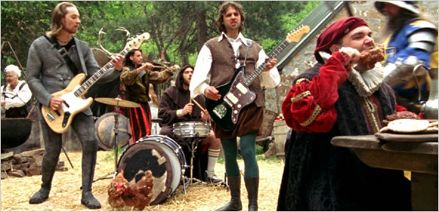
Borrowing Money & Credit

Slide 2
Borrowing Money
PRINCIPAL: The amount borrowed in the loan
INTEREST: The amount paid by the borrower for the privilege of using the money
COLLATERAL: Something of value offered by the borrower as a guarantee that the loan will be repaid.

Slide 3
COLLATERAL
Mortgage: The house is the collateral
Auto Loan: The Car is the collateral
What if the loan is not repaid?
The lender can foreclose on the house or repossess the car!!

Slide 4
HOW ARE LOANS REPAID?
Principal + Interest is divided into equal amounts called INSTALLMENTS
The length of the repayment is important in determining the monthly payment amount.
Longer loan = smaller payment
Shorter loan = larger payment

Slide 5
BUYING ON CREDIT
Charge purchases and pay for them LATER
Credit is offered by:
Banks
Department stores
Gasoline companies
Financial service firms: VISA, Mastercard

Slide 6
CREDIT RATINGS
Usually, Consumers can not use credit without first applying for it and being approved.
CREDIT RATING: an estimation of the probability of repayment
Ability to Pay
Assets
Credit History

Slide 7
CREDIT BUREAU
CREDIT BUREAU: credit reporting service; a business that specializes in collecting financial information about consumers.
Information comes from banks and other financial institutions
Stores
Credit card companies
Consumers can also request a copy of their own credit report to guarantee that their information is accurate

Slide 8
Because we just have to ……
WATCH THIS!
Free Credit Report.Com

Slide 9
FREECreditReport.com
The ads were lighthearted and catchy, with lyrics like: “F-R-E-E, that spells free creditreport.com, baby. Saw their ads on my TV, thought about going but was too lazy.”

Slide 10
FREECreditReport.com
So Mr. Steele headed to the site and filled out the information form, including his credit-card number, which he thought the site needed to verify his identity.
But a couple of months later, Mr. Steele noticed the site had been charging his credit card. While he believed he had signed up for a free report, he had actually enrolled in a credit-monitoring service that cost $14.95 a month. He says he never expected that it would cost anything.

Slide 11
FREECreditReport.com
“It’s called FreeCreditReport.com,” he said. “It’s kind of easy to make that assumption. I didn’t see anything in the process of signing up that said, ‘Hey, if you don’t cancel in 30 days or whatever, you’re going to get charged.’ ”
Consumer groups have long objected to sites like FreeCreditReport.com. Consumers may obtain a free credit report each year from the three major agencies, as mandated by an act that Congress passed in 2003. The only authorized site for that is AnnualCreditReport.com.

Slide 12
CREDIT TERMS
Customers have to be approved then they can start making credit purchases
The consumer is billed usually every 28 or 30 days
Consumers have credit limits or the maximum amount that the customer can purchase on credit

Slide 13
WHAT IF YOU DON’T PAY?
FINANCE CHARGE!!
The total cost of credit expressed in dollars and cents
INCLUDES: interest, service charges, miscellaneous fees.

Slide 14
WHAT IF YOUCHARGE ABOVE YOUR LIMIT?
USURY
Charging credit above your credit limit is called USURY and it’s illegal!

Slide 15
BANRUPTCY
A legal declaration of inability to pay debts
Remains on a person’s credit history for 14 years, making it nearly impossible to borrow $ or receive credit.

Slide 16
Credit in the Economy
Stimulates economic growth
The ability to spend borrowed money
Promotes economic stability
Credit, when used in moderation, promotes high employment and stable prices
We buy goods and services on credit and demand increases

Slide 17
Think about it…
Why do lenders charge interest on loans?
How can having too much credit be harmful to a consumer? Would you like to have a cc with a $50,000 credit limit?
Why is bankruptcy considered a last resort for a credit abuser? How can it affect a person’s life?
Is FREECreditReport.com really free? Why/Why not?

