Slide 1
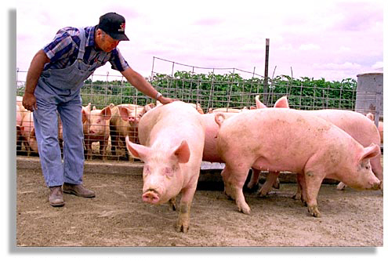
BONDS & FUTURES

Slide 2
WHY BUY BONDS?
Corporate and Government bonds are other forms of investment.
Return is usually lower than stock dividends but generally offer less risk
** If a company goes out of business, bond holders must be paid before stockholders.

Slide 3
CORPORATE BONDS
Corporations sell bonds to raise large sums of money that might be difficult to obtain from a bank
Come in units:
$1,000
$5,000
$10,000

Slide 4
CORPORATE BONDS
The investor purchases the bonds at face value
Face Value: the value listed on the bond when issued
Receives an annual interest payment
On the final maturity date, the investor collects the final interest payment and the principal

Slide 5
GOVERNMENT BONDS
Represent debt that the government must repay the investor.
US Treasury Department issues
Treasury Bonds
Treasury bills
Notes

Slide 6
TREASURY BILL
Short Term US Security
Maturity: 3 months-1 yr
Liquid and safe
Min. order = $10,000

Slide 7
TREASURY NOTE
Long term US security
Maturity: 1-10 yrs
Safe
Min. Order = $1,000-$5,000
Pays a stated interest rate semiannually
Redeem face value @ maturity

Slide 8
TREASURY BOND
Long term US Security
Maturity: 10-30 years
Safe
Min. Order = $5,000
Pays stated interest rate semiannually
Redeem face value @ maturity

Slide 9
Why Buy Futures?
Rather than trading stock, we can trade futures
Ag products:
Corn, wheat, soybeans and oats
Industrial Goods:
Steel, Coal, Precious metals and gemstones

Slide 10
Futures
Futures trading carries a very high risk
Investors must have specialized knowledge about the commodities being bought and sold

Slide 11
HOW DOES IT WORK?
Traders accept an investors $$ today in exchange for a promise to deliver a commodity to the investor at a later date.
Terms are usually stated in a contract.

Slide 12
HOGS- The Buyer (Investor)
Joanne agrees to pay a certain amount of money for a later delivery of hogs
She is hoping the price of hogs will increase so she can sell the hogs to turn a profit

Slide 13
HOGS- The Seller
The hog owner is hoping the price of hogs will drop so he will make a profit
If the hog owner had not sold the bogs in the advance, he or she would have received the later, lower market price.

