Slide 1
Basic Economic Concepts
Section 2

Slide 2
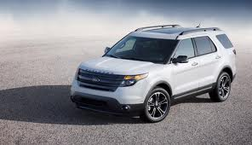
GOODS
A useful, tangible item
Book, car or computer that satisfies a want.
When manufactured goods are used to produce other goods and services, they are called CAPITAL GOODS

Slide 3
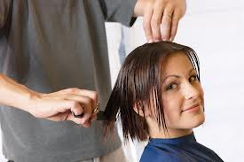
SERVICES
Work that is performed for someone
Haircuts, home repairs, forms of entertainment
work that doctors, lawyers, or teachers perform

Slide 4
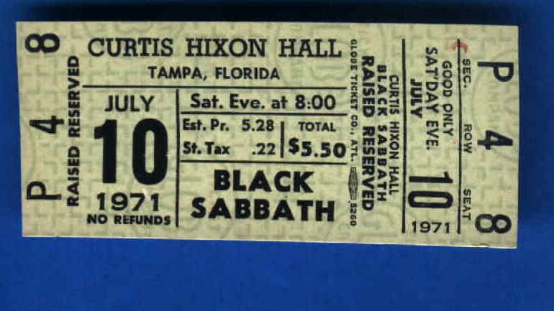
UTILITY
For something to have VALUE it must have UTILITY
The utility of a good or service may vary from one person to the next
One person may enjoy a rock concert, another person may not.

Slide 5
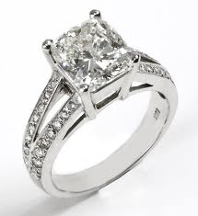
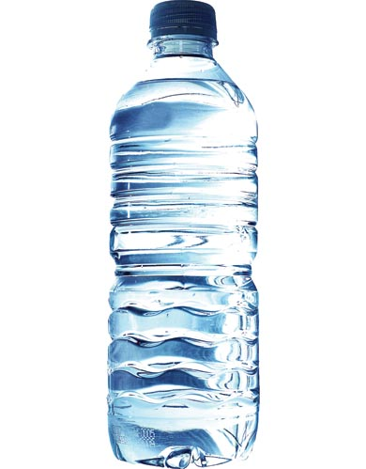
VALUE
For something to have economic value it must be scarce AND have utility.
Diamonds are scarce AND have utility.
Water has UTILITY but it is not scarce enough to give it much value

Slide 6
WEALTH
The accumulation of products that are tangible, scarce, useful, and transferable from one person to another is wealth.
Natural resources, factories, stores, houses, motels, theaters, furniture, clothing, books, highways, video games, etc.

